Slide 1


Human DEVELOPMENT INDEX
Is human development going wrong?
IRONHACK, JOÃO QUINTELA DAFT 2020

Slide 2
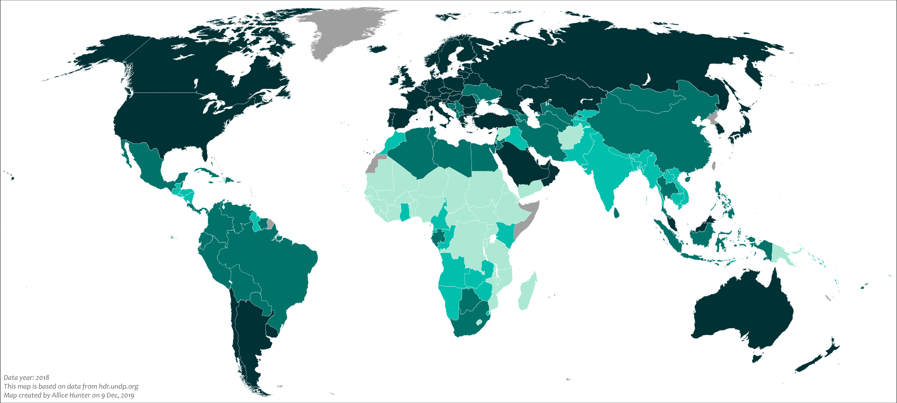
HUMAN DEVELOPMENT INDEX: WHAT IS IT?
“(…) a statistic composite index of life expectancy, education (Literacy Rate, Gross Enrollment Ratio at different levels and Net Attendance Ratio) , and per capita income indicators, which are used to rank countries into four tiers of human development. “

Slide 3




Problem: are there worrying trends in more developed countries?
Could certain factors be significantly correlated with HDI?
Low birth rate Bipolar disorders Schizophrenia disorders Eating disorders
Mental disorders

Slide 4






WORKFLOW ANALYSIS
Data collection
How: ourworldindata.org
Data Cleaning
How:
Draw insights
How: inferential statistics

Slide 5
How to address the problem
My approach:
1. Select multiple interesting variables (non related with HDI variables: literacy, gdp, etc.)
Source: ourworldindata.org
Inferential statistics: Multilinear regression analysis

Slide 6
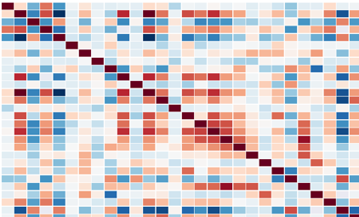
How to address the problem
2. Filter them through a correlation matrix
Inferential statistics: Multilinear regression analysis

Slide 7
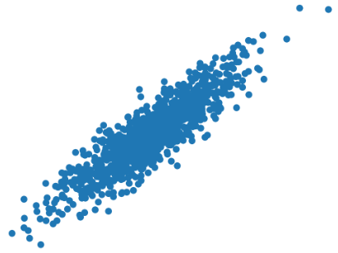
How to address the problem
3. Select strongly correlated variables (corr > 0.5) with HDI
Compute Multilinear regression for these
Inferential statistics: Multilinear regression analysis

Slide 8
How to address the problem
4. Select correlated variables with a positive connotation
Compute Multilinear regression for these
Inferential statistics: Multilinear regression analysis

Slide 9
How to address the problem
5. Select correlated variables with a negative connotation
Compute Multilinear regression for these
Inferential statistics: Multilinear regression analysis

Slide 10
How to address the problem
6. Benchmark all the multilinear regressions
Compare all R² and draw insights
Inferential statistics: Multilinear regression analysis
All variables
R²
Strongly correlated var
Strongly correlated var and positive connotation
Strongly correlated var and negative connotation

Slide 11
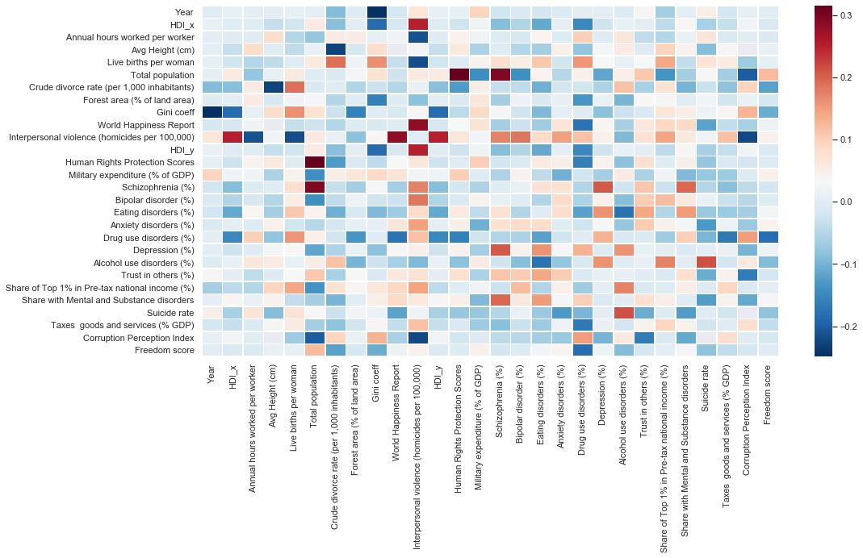
Choose the best correlation METHOD
Compute average difference between Pearson and Spearman.
Difference: +0.0008890535164758478
Matrix of the difference between Pearson and Spearman
Pearson
Outcome: Go for Pearson correlation method
Spearman

Slide 12
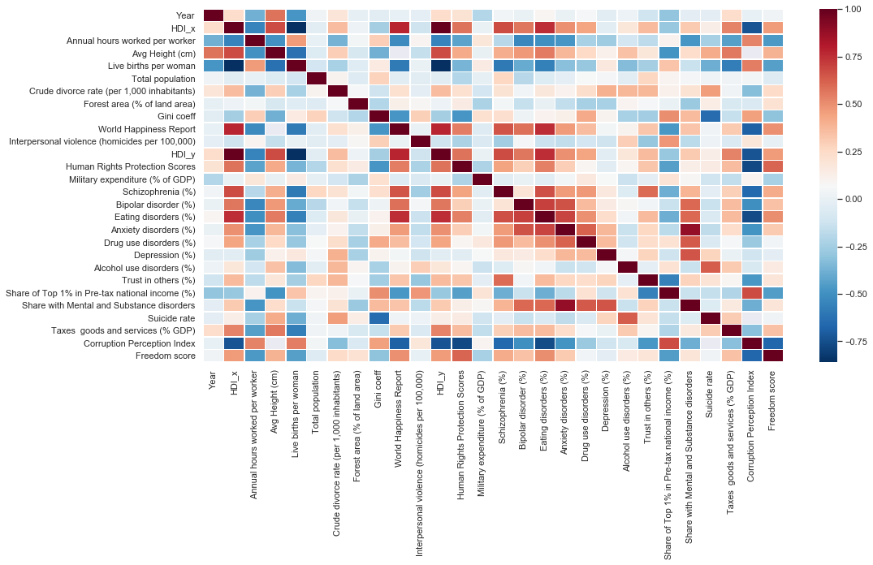
first trial: MULTILINEAR REGRESSION WITH 18 VARIABLES
Starting point: 18 parameters
Multilinear regression’s R²: 0.80
Pearson correlation matrix
Annual hours worked by worker
Average height by year of birth
Children per woman
Divorces per 1000 people
Forest area (%)
Gini coefficient
Happiness cantril ladder
Homicide rate
Human rights scores
Military expenditure
Prevalence by mental and substance disorders
Self reported trust
Suicide rates
Tazes on goods and services GDP
Corruption perception index
Freedom of the press status
Population

Slide 13
SECOND trial: filter strongly correlated PARAMETERS
# Outcome variables: 9 parameters
Multilinear regression’s R² : 0.77
Second trial Pearson correlation matrix
World happiness report
Live births per woman
Corruption perception Index
Average height (cm)
Eating disorders
Human Rights Protection Scores
Annual work hours worked per worker
Schizophrenia
Bipolar disorders
Taxes goods and services (%GDP)

Slide 14
THIRD trial: strongly correlated PARAMETERS with a positive connotation
# Outcome variables: 5 parameters
Multilinear regression’s R² : 0.64
Third trial Pearson correlation matrix
Chosen parameters:
World happiness report
Corruption perception Index
Human Rights Protection Scores
Annual work hours worked per worker
Taxes goods and services (%GDP)

Slide 15
THIRD trial: strongly correlated PARAMETERS with a negative connotation
# Outcome variables: 4 parameters
Multilinear regression’s R² : 0.66
Third trial Pearson correlation matrix
Chosen parameters:
Live births per woman
Eating disorders
Schizophrenia
Bipolar disorders

Slide 16
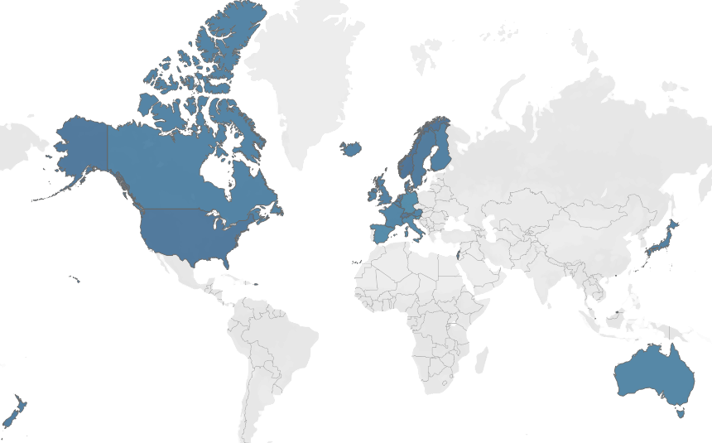
Insights…
Countries with higher HDIs tend to…
Be more happy
Have the worst fertility rates
Be less corrupt
Work less hours
Score higher in mental disorders
Disclaimer: likely bias in data
[underdiagnosis in less
developed countries]
Have taller population
Countries scoring HDI higher than 85% of others

Slide 17
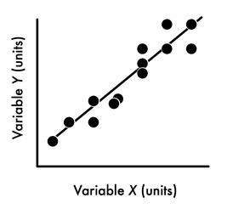
A HUMAN DEVELOPMENT INDEX EQUATION
HDI (Y) = 0.02327X¹+ 0.002594 X² + 0.000985 X³ + (…)
HDI
X¹+X²+X³+(…)

Slide 18
Struggles…
From a technical point of view…
Selecting parameters
Dilemma: strongly correlated variables with HDI tended to be unusually correlated with each other.
It’s rather difficult to overcome this…
Data Cleaning
Ensuring no bias in countries’ columns
Merging pandas dataframes

Slide 19
anY QUESTIONS?
Feel free to ask

